Slide 1

Python scientific computing tutorials
Presenter: Lai Wei
lw36@email.sc.edu

Slide 2
Overview of Today's Topics
Key Tools and Data Types:
Pymatgen: A core Python library for materials analysis, especially for creating and manipulating materials' structural data.
Composition Data: Information about the elemental composition of materials, crucial for predicting properties and behavior.
Structure Data: Describes the three-dimensional arrangement of atoms within materials, essential for understanding material properties.
VESTA: Visualization software for viewing and analyzing three-dimensional crystallographic data and models.
Matminer: An open-source library for extracting and manipulating materials data, facilitating advanced materials data mining.

Slide 3
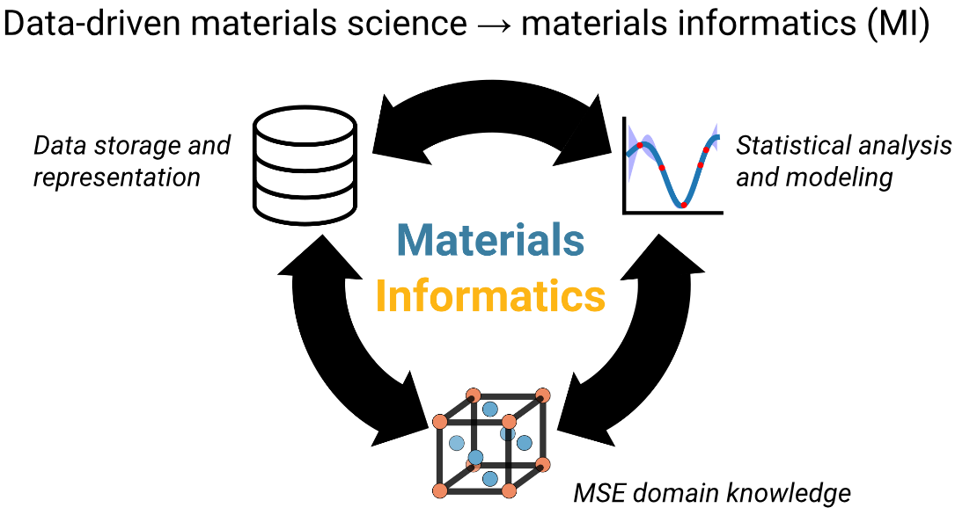
What is materials informatics?
Materials informatics is an exciting field where we use computers and lots of data to explore and create new materials. It's like combining the study of materials with the power of computers to make amazing discoveries faster than ever before!
Imagine you're trying to build the perfect skateboard. You want it to be super strong, but also lightweight. In the past, scientists and engineers would have to test many different materials one by one, which could take years.
But with materials informatics, we can:
Use big data and machine learning to study materials faster
Predict new materials before making them in real life
Figure out properties like strength or conductivity using simulations

Slide 4
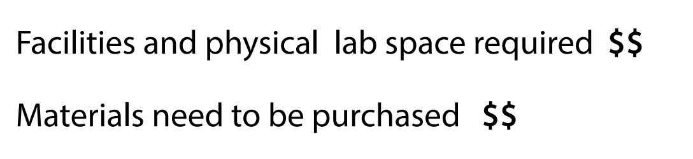
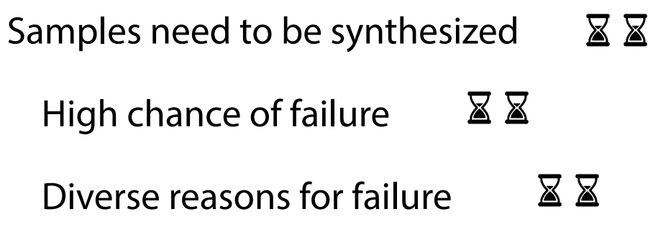
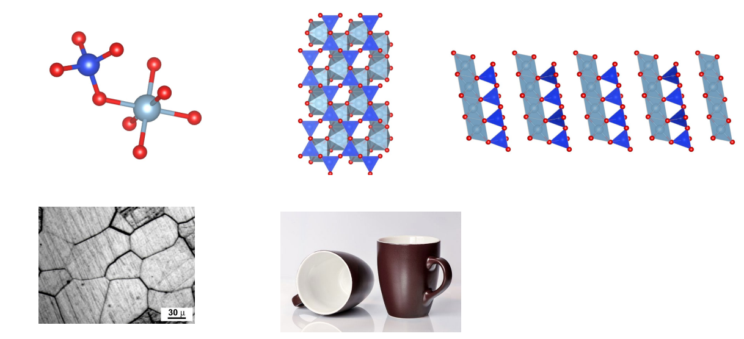
Why we need materials informatics?
Discovering New Materials:
Helps scientists find new materials faster.
Allows us to design materials with specific properties, like super strength or conductivity.
Saving Time and Money:
Reduces the time it takes to develop new materials.
Saves costs by minimizing trial and error in experiments.
Understanding Properties:
Helps us understand why materials behave the way they do.
Predicts how materials will perform in different conditions.
Environmental Impact:
Enables development of eco-friendly materials.
Reduces waste by improving material efficiency.

Slide 5
Open-Source Materials Informatics Resources
Materials Project
Extensive database of material properties and interactive tools.
Website: materialsproject.org
MatWeb
Free database of material property data for metals, plastics, ceramics, and more.
Website: matweb.com
Materials informatics resources
Computational materials workflow libraries: Pymatgen, ASE
Materials informatics libraries: Matminer, MEGNet
Databases: Materials Project, OQMD, ICSD
Visualization, data sharing, and more for materials discovery.
Website: Materials informatics resources on GitHub

Slide 6
Pymatgen
What is pymatgen?
Pymatgen (Python Materials Genomics) is the code that powers all of the scientific analysis behind the Materials Project. It includes a robust and efficient libraries for the handling of crystallographic structures and molecules, in addition to various mathematical and scientific tools for the handling and generation of materials data. For more details, see the pymatgen website.
Imagine pymatgen as a super-smart digital toolbox for materials scientists:
Structure Builder: Like a virtual Lego set, it helps you build and manipulate atomic structures.
Property Calculator: Acts as a crystal ball to predict material properties without actual experiments.
Data Analyzer: Works like a detective, finding patterns and insights in large sets of materials data.
Simulation Helper: Prepares and processes data for complex computer simulations of materials.

Slide 7
Pymatgen
How do I install pymatgen?
pymatgen can be installed via pip:
pip install pymatgen
or conda:
conda install pymatgen
Verify we have pymatgen installed
import pymatgen.core
We can show the specific version of pymatgen installed:
print(pymatgen.core.__version__)

Slide 8
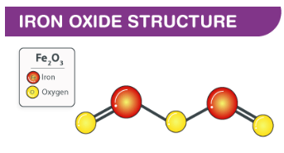
Pymatgen: Composition data
Composition data refers to the chemical makeup of a material. It's a fundamental concept that describes what elements are present in a material and in what proportions.
Example of Composition Data
Iron Oxide (Fe2O3):
Contains 2 parts Iron (Fe).
Contains 3 parts Oxygen (O).
Commonly known as rust, used in various industrial applications.
Key Operations with Composition Data (Using Pymatgen)
Creating a Composition: Instantiate composition from a formula.
comp1 = Composition("Fe2O3")
Accessing Elements: Retrieve the types of elements and their proportions.
Elements in comp1: {comp1.elements}
Analyzing Properties: Compute molecular weight, check for metallicity, etc.
Weight of comp1: {comp1.weight:.2f} g/mol

Slide 9
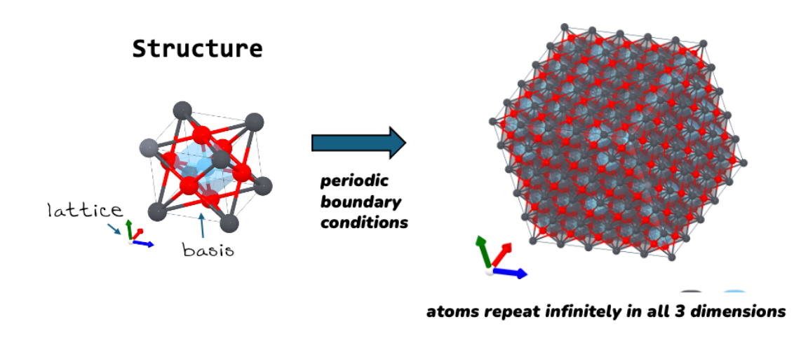
Pymatgen: Structure data
What is Structure Data?
Describes the arrangement of atoms within a material.
What is CIF Data?
CIF stands for Crystallographic Information File.
It's a type of structure data specifically formatted to include details about the positions, types of atoms, and their bonding within a lattice.
Why is this Important?
Predicting Material Properties: Fundamental for engineering materials with desired mechanical, electronic, and optical behaviors.
Research and Development: Helps scientists and engineers reduce trial and error, saving time and resources.
A supercell is a larger version of a crystal unit cell.
Imagine a single building block (unit cell) of a crystal.
A supercell is made by repeating this block infinite times in different directions.

Slide 10
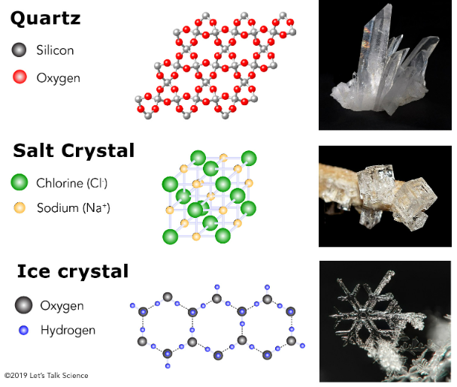
VESTA: Visualize Crystal Structures from cif files
What is VESTA?
VESTA is a powerful software for visualizing crystal structures from CIF data files.
It's widely used in materials science for displaying three-dimensional atomic arrangements of crystals.
Where to Download VESTA:
Free download available at: VESTA Download

Slide 11
Visualize Structures using python code
Visualizing crystal structures from CIF files using code: visualize structures
How to use it?
The script accepts various command-line arguments to customize the visualization of CIF files, such as the type of visualization, resolution, and supercell configuration.
parser.add_argument('-i', '--input', type=Path, help='folder to get CIFs from')
parser.add_argument('-s', '--style', choices=['spacefilling', 'ballstick'], help='structure drawing type', default='spacefilling')
parser.add_argument('-o', '--output', type=Path, help='folder to put drawings in', default='images')
parser.add_argument('-c', '--cell', type=scale_parse, help='supercell: format either as 3 or 3,3,3', default='1')
parser.add_argument('-r', '--rez', type=int, help='resolution (0-10): more takes longer but is better', default='10')
for example:
# Navigate to the script's directory
cd path/to/script
# Run the script with specified parameters python
visual_cif.py --input /home/weilai/SUMMER-CAMP/cifs/ --style spacefilling --output ~/images --cell 1 --rez 10
# Check the output image
"Image saved as ~/images/SrTiO3.png"

Slide 12
Pymatgen: Structure data
Creating a Structure
Example: Define a cubic lattice and create a structure for Iron Oxide.
lattice = Lattice.cubic(4.2) # lattice parameter in Ångström
structure = Structure(lattice, ["Fe", "O"], [[0, 0, 0], [0.5, 0.5, 0.5]])
Accessing and Modifying Structure Information
Retrieve information about lattice, sites, and atoms.
Number of sites: len(structure)
Species at first site: structure[0].species
Modify the structure (e.g., replace an atom, scale the lattice).
structure.replace(0, 'Mg') # Replace Fe with Mg at the first site

Slide 13
Pymatgen: Structure data
You can also load a Structure from a CIF file:
Download structure file from Materials Project website: Materials Project
PTO_structure_from_cif = Structure.from_file("files/PbTiO3.cif")
print(PTO_structure_from_cif) # print the structure - note the oxidation states!
PTO_structure_from_cif

Slide 14
Pymatgen: Structure data
Loading a structure from an API (Materials Project)
Let’s load a crystal structure from an online database (The Materials Project)
Using the API will give you instant access to >150,000 crystal structures that are available on the Materials Project web site
Materials Project website: Materials Project

Slide 15
Pymatgen: Structure data
Analyzing Structure Data
Neighbor Analysis
Identify neighboring atoms within a certain radius.
neighbors = structure.get_neighbors(structure[0], 2) # 2 Å radius
Symmetry and Properties
Determine the space group, symmetry operations, and calculate the volume of the unit cell.
Space group: structure.get_space_group_info()
Volume of unit cell: structure.volume
Visualizing Structures
Tools and techniques to visualize complex crystal structures for better understanding and analysis.
Suggested software: VESTA, CrystalMaker, python code, etc.

Slide 16
Pymatgen: Structure data
Structure Data Examples: What can you do directly with a Structure?
Creating Structure objects
Accessing structure information
Site-specific information
Neighbor analysis
Structure properties
Symmetry and system properties

Slide 17
Matminer
What is Matminer?
Matminer is an open-source library for performing materials data mining.
It facilitates the extraction of materials data from various sources, manipulation of materials data, and running data mining algorithms on materials data.

Slide 18
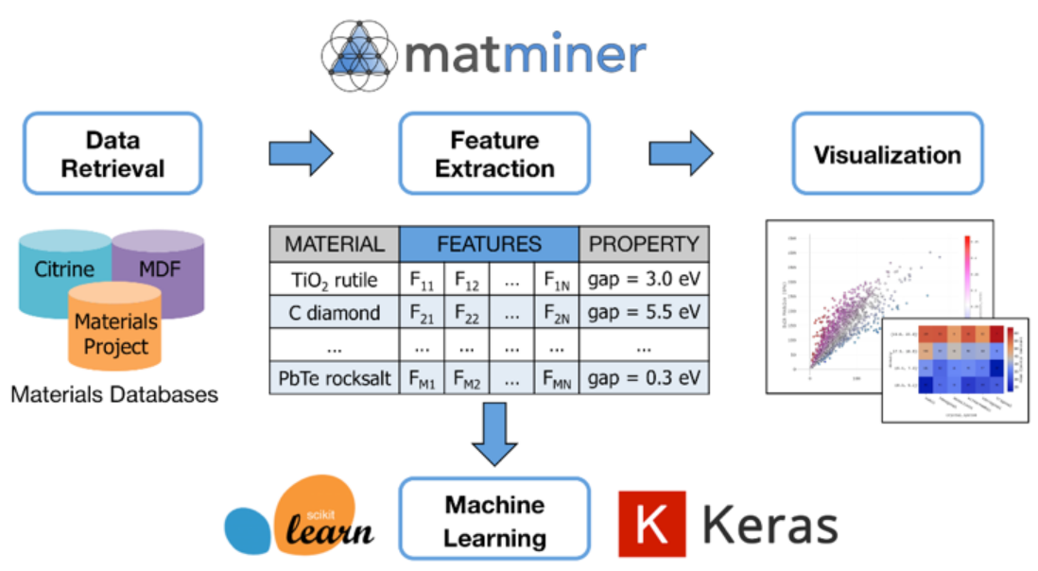
Matminer

Slide 19
Matminer
Installation
pip install matminer
Importing Essential Libraries
from matminer.data_retrieval.retrieve_MP import MPDataRetrieval
from matminer.featurizers.composition import ElementProperty
from sklearn.ensemble import RandomForestRegressor

Slide 20
Matminer
Feature Engineering
Extracting meaningful features from material compositions:
# Add features based on element properties
ep_feat = ElementProperty.from_preset(preset_name="magpie")
df = ep_feat.featurize_dataframe(df, col_id="composition")
Machine Learning
Predicting material properties using Random Forest:
# Prepare features and target
X = df.drop(['band_gap'], axis=1)
y = df['band_gap']
# Train a Random Forest model
model = RandomForestRegressor(n_estimators=100)
model.fit(X, y)
# Display model accuracy
print(f"Model Accuracy: {model.score(X, y)}")

Slide 21
Matminer
Matminer Examples: Data Mining in Materials Science
1. Loads the "elastic_tensor_2015" dataset.
2. Displays the first few rows and column names of the dataset.
3. Shows properties of the first material in the dataset, including its formula, number of sites, volume, and elastic properties.
4. Finds the material with the highest bulk modulus.
5. Calculates and prints average properties for all materials.
6. Creates a scatter plot of bulk modulus vs shear modulus.
7. Creates a histogram of the number of sites in the materials.
Matminer Tutorials - The Matminer tutorial series uses interactive Jupyter notebooks to walk through the basic steps of materials informatics: data retrieval, featurization, machine learning, and data evaluation/visualization.

Slide 22
THANKS!
Name: Lai Wei
Email: lw36@email.sc.edu

